Slide 1
COMP 4290
Week 8 - Wednesday

Slide 2
Last time
Web security
Web attacks

Slide 3
Questions?

Slide 4
Project 2

Slide 5
Assignment 3

Slide 6
Abiral Pokarel Presents

Slide 7
Back to E-mail Attacks

Slide 8
E-mail spoofing
SMTP is the protocol for sending e-mail
It's very straight-forward
The from field is easy to spoof
There are protocols with authentication built in, but regular SMTP is entrenched how
You can never trust header information in an e-mail

Slide 9
Phishing
Phishing is when an e-mail tries to trick someone into giving out private data or doing something else unsafe
Spear phishing is phishing that targets a specific individual
  Details about that user's life or accounts might be included
Whaling is a term used for spear phishing of rich people or celebrities
  They have more money
  Many of their personal details could be public

Slide 10
Secure e-mail systems
PGP (Pretty Good Privacy) is a system that uses the encryption mechanisms we described to send safe e-mails
  The public key system uses a decentralized web of trust where you add your friends' keys to your web and get keys for their friends and friends of friends
S/MIME is a standard that is like PGP, but it uses hierarchies of trust based on certificates from central authorities instead of a web

Slide 11
OS Security

Slide 12
OS security
The OS has to enforce much of the computer security we want
  Multiple processes are running at the same time
We want protection for:
  Memory
  Hard disks
  I/O devices like printers
  Sharable programs
  Networks
  Any other data that can be shared

Slide 13
OS issues
The OS has many functions that involve computer security
  Enforced sharing
  Interprocess communication
  Protection of OS data
  Guaranteed fair service
  Interface to hardware
  User authentication
  Memory protection
  File and I/O device access control
  Allocation and access control of general objects

Slide 14
OS history
Originally, there were only single users
  Users programmed directly on the hardware
Multitasking
  Modern systems run multiple processes (which do not share memory)
  Each process can have multiple threads (which do share memory)
    The book also mentions tasks, which are the same as threads on many systems
  We don't want processes to interfere with each other

Slide 15
Virtualization
Virtualization is key to OS security, particularly of memory and disk usage
Virtualization means providing one visible set of resources that are actually built on other resources
  User A only sees user A resources because it sees a virtual machine tailored for it
A hypervisor is the program that implements the virtual machine, acting as mediator between virtual resources and real resources
A sandbox is a virtual machine that prevents programs from endangering the rest of the system

Slide 16
Separation
OS security is fundamentally based on separation
  Physical separation: Different processes use different physical objects
  Temporal separation: Processes with different security requirements are executed at different times
  Logical separation: Programs cannot access data or resources outside of permitted areas
  Cryptographic separation: Processes conceal their data so that it is unintelligible

Slide 17
Memory Protection

Slide 18
Memory protection
Protecting memory is one of the most fundamental protections an OS can give
  All data and operations for a program are in memory
  Most I/O accesses are done by writing memory to various locations
Techniques for memory protection
  Fence
  Base/bounds registers
  Tagged architectures
  Segmentation
  Paging

Slide 19
Fence
A fence can be a predefined or variable memory location
Everything below the fence is for the OS
If a program ever tries to access memory below the fence, it either fails or is shut down
As with many memory schemes, code needs to be relocatable so that the program is written as if it starts at memory location 0, but actually can be offset to an appropriate location
OS Memory
Fence
User Program Memory

Slide 20
Base/bounds registers
In modern systems, many user programs run at the same time
We can extend the idea of a fence to two registers for each program
  The base register gives the lowest legal address for a particular user program
  The bounds register gives the highest legal address for a particular user program
OS Memory
Base A
Program A Memory
Bounds A
Program B Memory
Program C Memory

Slide 21
Tagged architectures
The idea of base and bounds registers can be extended so that there are separate ranges for the program code and for its data
It is possible to allow data for some users to be globally readable or writable
  But this makes data protection all or nothing
Tagged architectures allow every byte (or perhaps defined groups of bytes) to marked read only, read/write, or execute only
Only a few architectures have used this model because of the extra overhead involved

Slide 22
Segmentation
Programmer's View
OS
View
Segmentation has been implemented on many processors including most x86 compatibles
A program sets up several segments such as code, data, and constant data
  Writing to code is usually illegal
  Other rules can be made for other segments
A memory lookup is both a segment identifier and an offset within that segment
For performance reasons, the OS can put these segments wherever it wants and do lookups
  Segments can be put on secondary storage if they are not currently in use
The programmer sees a solid block of memory
Code
Constant Data
Constant Data
Data
Data
Other users have their own segments
Code

Slide 23
Paging
Programmer's View
OS
View
Paging is a very common way of managing memory
A program is divided up into equal-sized pieces called pages
  An address is page number and an offset
Paging doesn't have the fragmentation problems that segmentation does
  It also doesn't specify different protection levels
Paging and segmentation can be combined to give protection levels
Page 0
Page 1
Page 2
Page 2
Page 3
Page 0
Other users have their own pages
Page 1
Page 3

Slide 24
Trusted Operating Systems

Slide 25
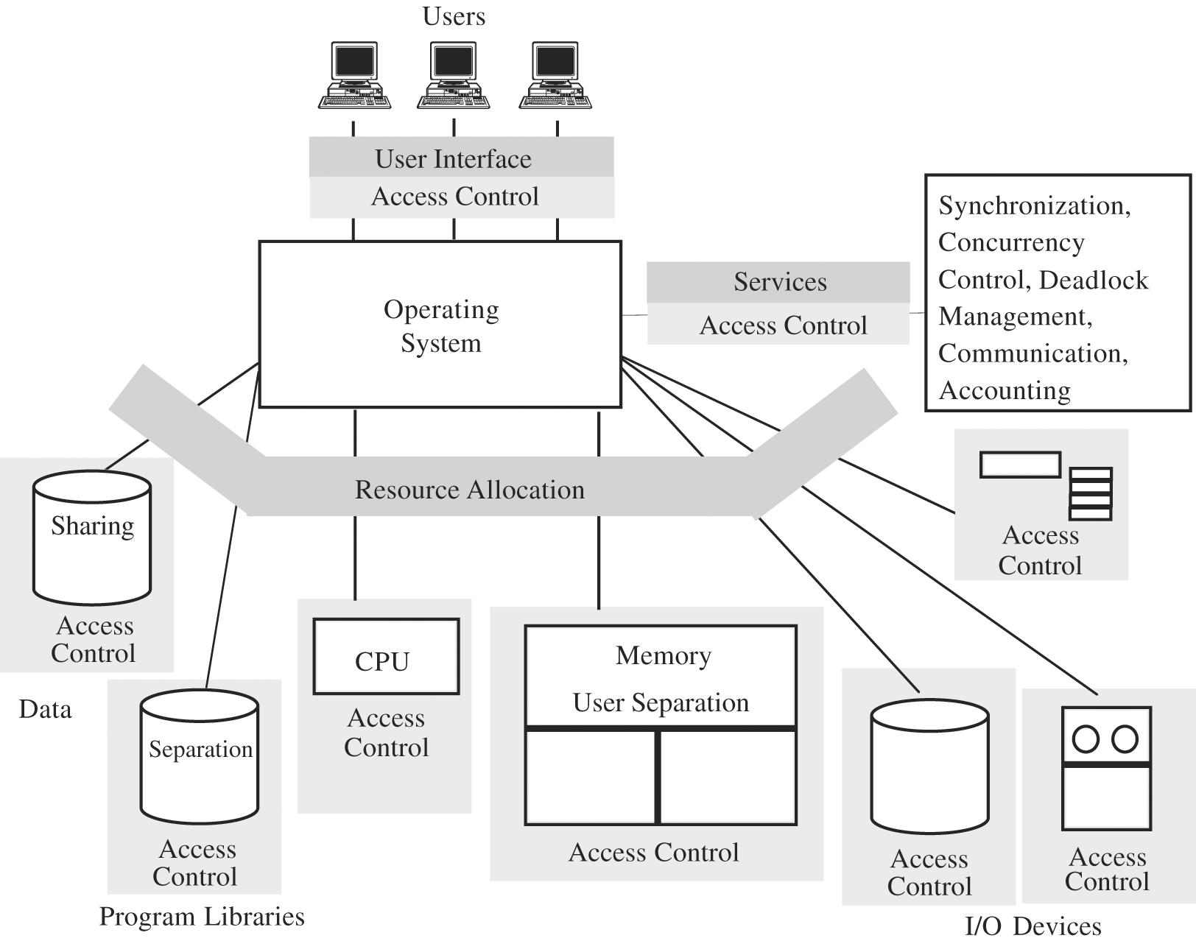
Trusted OS
A trusted OS is similar to a normal OS, except that it puts a layer of access control around everything
A trusted OS will typically be careful about:
  User identification and authentication
  Mandatory access control
  Discretionary access control
  Object reuse protection
  Complete mediation
  Trusted paths
  Auditing
  Intrusion detection

Slide 26
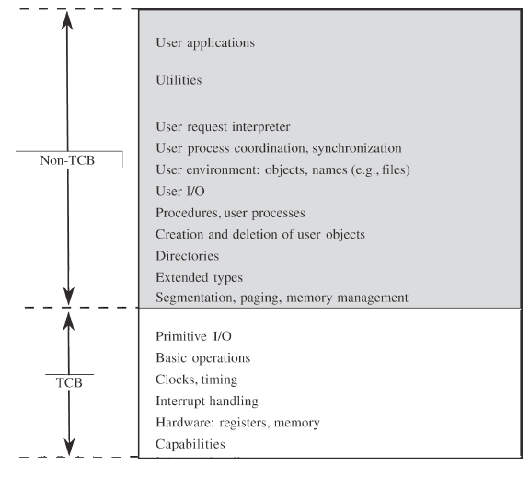
Trusted Computing Base
The trusted computing base or TCB is the parted of a trusted OS that enforces the security policy
It has to handle the most hardcore stuff

Slide 27
Mandatory and discretionary access control
Mandatory access control (MAC) means that the controls are enforced by rules in the system, not by user choices
  In a few slides, we'll talk about Bell-La Padula, a classic MAC system
Discretionary access control (DAC) means that the user has control over who can access the objects he or she owns
  Linux and Windows are largely DAC systems
Many real systems have elements of both

Slide 28
Object reuse
When a file is deleted, it isn't actually deleted
  It's blocks are unlinked from the file system
When you create a new file, it usually uses a block from an old deleted file
You can examine the contents of that block and reconstruct some or all of the deleted file
  Software is available for home users to undelete files
  Digital forensics experts use more powerful tools in criminal investigations
The problem is that object reuse allows for security violations
A regular OS often does this and other kinds of object reuse for efficiency
A trusted OS will sacrifice efficiency for security

Slide 29
Complete mediation and trusted paths
Complete mediation means that every access goes through the system
  All resources are checked
  Past permissions are no guarantee of future permissions
A trusted path means an unmistakable process for performing protected tasks
  Phishing is the opposite of a trusted path
  Some attacks on OS users rely on getting them to download a file with the same name as a system command, which will then be run instead if they execute from the same directory

Slide 30
Auditing
Trusted systems also keep an audit log of all security-relevant actions that have been taken
Unfortunately, audit logs can become huge
Even if an illegal access is known to have happened, it might be impossible to find it in the logs
Audit reduction is the process of reducing the size of the log to critical events
  This may require sophisticated pattern recognition software

Slide 31
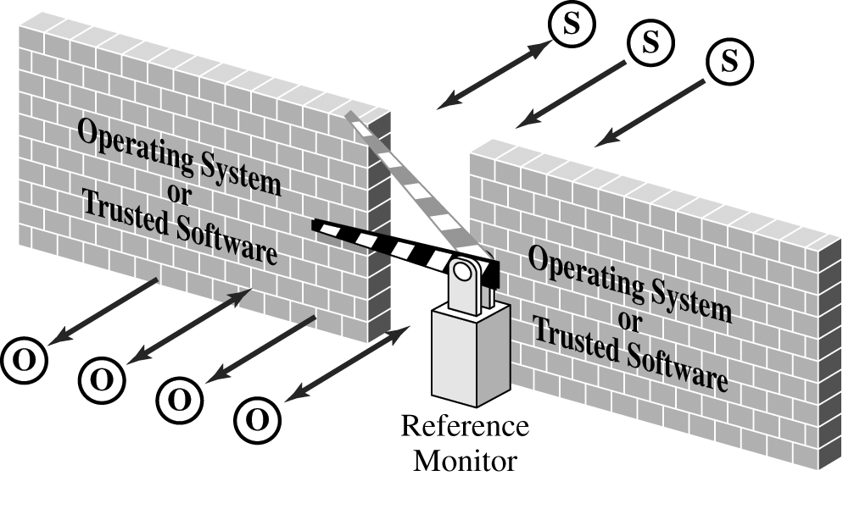
Kernelized design
One approach to making a trusted system is a kernelized design
A security kernel is the low level part of the OS that enforces security mechanisms
  It can be a unified layer sitting between hardware and the rest of the OS
  Or it can be spread throughout the entire OS
The reference monitor is the most important part of the security kernel
  It controls accesses to objects
  It should be tamperproof, unbypassable, and analyzable

Slide 32
Mandatory Access Control

Slide 33
Bell-La Padula Model

Slide 34
Bell-La Padula overview
Confidentiality access control system
Military-style classifications
Uses a linear clearance hierarchy
All information is on a need-to-know basis
It uses clearance (or sensitivity) levels as well as project-specific compartments
Unclassified
Confidential
Secret
Top Secret
Restricted

Slide 35
Security clearances
Both subjects (users) and objects (files) have security clearances
Below are the clearances arranged in a hierarchy
Clearance Levels | Sample Subjects | Sample Objects
Top Secret (TS) | Tamara, Thomas | Personnel Files
Secret (S) | Sally, Samuel | E-mail Files
Confidential (C) | Claire, Clarence | Activity Log Files
Restricted (R) | Rachel, Riley | Telephone List Files
Unclassified (UC) | Ulaley, Ursula | Address of Headquarters

Slide 36
Simple security condition
Let level_{O} be the clearance level of object O
Let level_{S} be the clearance level of subject S
The simple security condition states that S can read O if and only if the level_{O} ≤ level_{S} and S has discretionary read access to O
In short, you can only read down
In a few slides, we will expand the simple security condition to make the concept of level

Slide 37
*-Property
The *-property states that S can write O if and only if the level_{S} ≤ level_{O} and S has discretionary write access to O
In short, you can only write up

Slide 38
Basic security theorem
Assume your system starts in a secure initial state
Let T be all the possible state transformations
If every element in T preserves the simple security condition and the *-property, every reachable state is secure
This is sort of a stupid theorem, because we define “secure” to mean a system that preserves the security condition and the *-property

Slide 39
Upcoming

Slide 40
Next time…
Finish access control models
Rootkits
Network basics
Network threats
Network attacks
Adam Garantche presents

Slide 41
Reminders
Read sections 6.1 and 6.2
Keep working on Project 2
Work on Assignment 3
  Due on Friday

